Slide 1
#coronavirus in Italy
How you feel about it?
Or Shalit | Tzvi Puchinsky | Alla Kitaieva

Slide 2
Our goal
Italy’s story

Slide 3
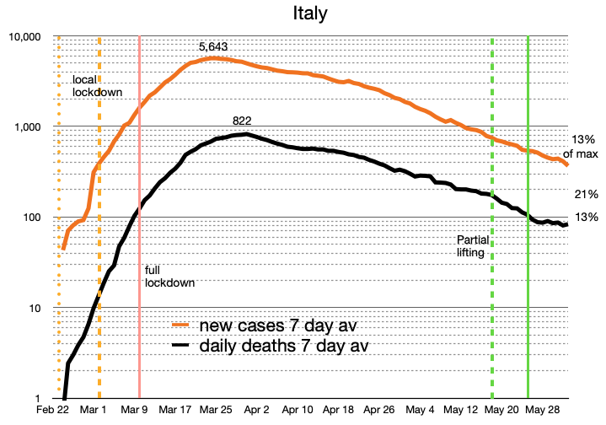
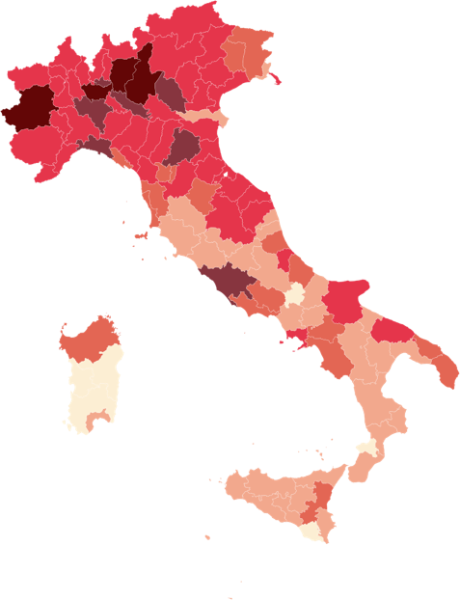

Italy’s story
The COVID-19 virus that started in China affected the world and our daily routine.
One of the countries that felt the COVID-19 in the worst case scenario is Italy.
With rapid infection rate and high death toll.
As part of our studies we decided to use our knowledge to see if we can analyze the overall mood of twitter users in Italy during specific events and specific areas.

Slide 4
To do list

Slide 5
Steps
Create a timeline of events
Define queries and geo locations
Download the data and arrange it
Pre-processing and classifying tweets
Visualize the data

Slide 6
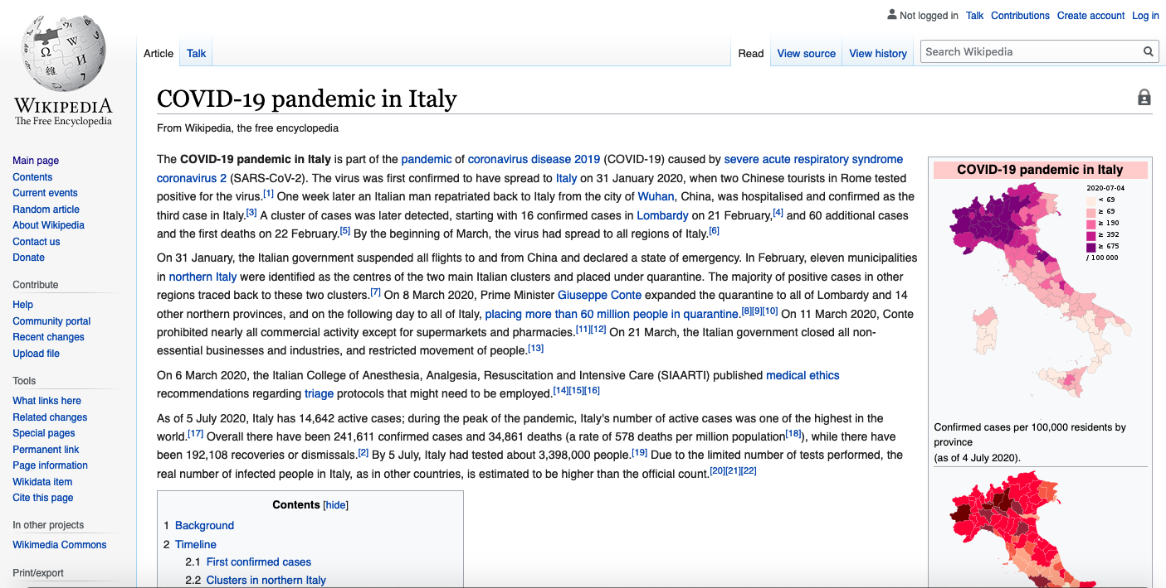
Create timeline of events
The first step is to establish a timeline of events, from the first confirmed case through number of key events and the progression of cases in Italy.
Using the Wikipedia article “COVID-19 pandemic in Italy” a rough timeline established to use as a guideline for tweets scraping.
Create a timeline of events
Define queries and geo locations
Download the data and arrange it
Pre-processing and classifying tweets
Visualize the data

Slide 7
Timeline Style
Quarantine of more than 50,000 people from 11 municipalities in Northern Italy.
President of Lazio and leader of the Democratic Party, Nicola Zingaretti, tested positive for COVID-19.
On 31 January, the first two cases of COVID-19 were confirmed in Rome.
Italy saw the first fall in the number of active cases.
Whole country lockdown.
31/01/2020
22/02/2020
07/03/2020
10/03/2020
20/04/2020
21/02/2020
24/02/2020
08/03/2020
05/04/2020
Cases and deaths starts to appear in areas such as: Milan, Pavia, Lombardy region, Lazio region etc.
Number of cases increases and the case count is 229 with number of deaths.
Region of Lombardy together with 14 additional northern and central provinces in Piedmont, Emilia-Romagna, Veneto, and Marche, were put under lockdown.
Italy had the lowest number of new daily deaths in two and a half weeks.

Slide 8
Define queries and geo locations
Date | Location | Geo | Radius | Description
31/01/2020 | Rome | 41.902782,12.496365 | 15km | Location
21/02/2020 | Veneto | 45.735802,11.861790 | 82km | Location
21/02/2020 | Casalpusterlengo | 45.177811,9.650170 | 15km | Location
21/02/2020 | Lombardy | 45.657581,9.963600 | 100km | Location
21/02/2020 | Milan | 45.464203,9.189982 | 15km | Location
21/02/2020 | Pavia | 45.191652,9.172623 | 15km | Location
21/02/2020 | Emilia-Romagna | 44.551499,10.926799 | 100km | Location
21/02/2020 | Piedmont | 45.082506,7.919908 | 100km | Location
22/02/2020 | Rome | 41.902782,12.496365 | 500km | Event
23/02/2020 | Crema | 45.378779,9.682331 | 15km | Location
23/02/2020 | Pavia | 45.191652,9.172623 | 15km | Location
24/02/2020 | Bergamo | 45.692919,9.685191 | 15km | Location
24/02/2020 | Codongo | 45.163569,9.704778 | 15km | Location
25/02/2020 | Como | 45.808555,9.095428 | 15km | Location
07/03/2020 | Rome | 41.902782,12.496365 | 500km | Event
08/03/2020 | Rome | 41.902782,12.496365 | 500km | Event
10/03/2020 | Rome | 41.902782,12.496365 | 500km | Event
05/04/2020 | Rome | 41.902782,12.496365 | 500km | Event
20/04/2020 | Rome | 41.902782,12.496365 | 500km | Event
The goal is to analyze specific regions and Italy in general, to do so specific queries needed.
Using python project Twint to download tweets with geo-location where the location is the center and define radius from that location to collect tweets in time range.
All the queries used the same query hashtag: #coronavirus
Create a timeline of events
Define queries and geo locations
Download the data and arrange it
Pre-processing and classifying tweets
Visualize the data

Slide 9
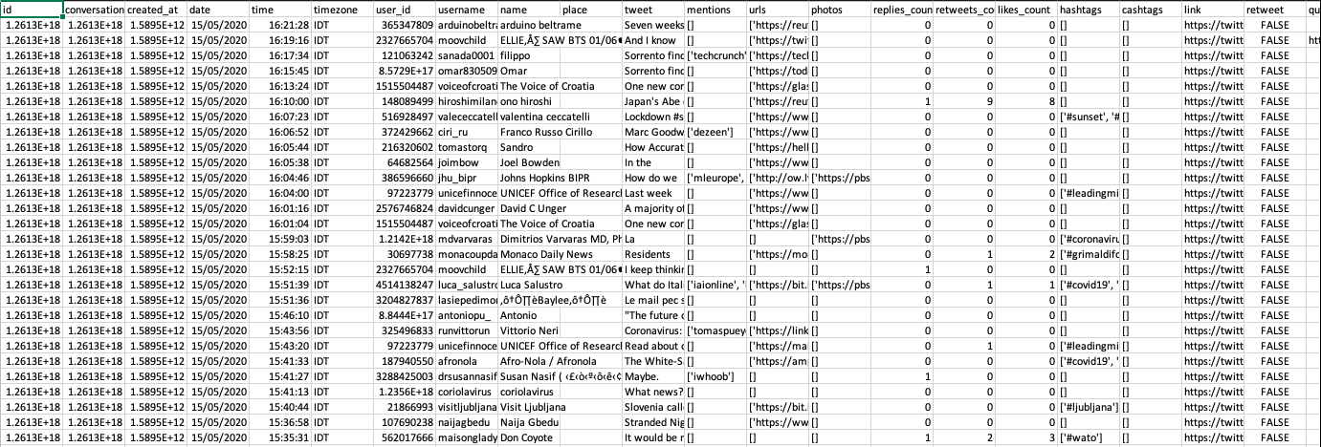
Download the data and arrange it
Using the Twint each query used to get as much as possible tweets with the parameters defined.
Each query results saved in a separate csv file for further processing.
The largest file contain over 11000 tweets where the smallest contained only 8 tweets.
Create a timeline of events
Define queries and geo locations
Download the data and arrange it
Pre-processing and classifying tweets
Visualize the data

Slide 10
Pre-processing and classifying tweets
Using a trained convolution neural network to classify the tweets into two separated classes: negative and positive tweets.
Each tweet is pre-processed to eliminate any unwanted signs and characters.
Removing @.
Removing URL links.
Keeping only letters.
Removing additional whitespaces.
Than the pre-processed tweet goes as input to the CNN.
The final result is that we have for each location query, a set of:
pre-processed tweets.
classification to negative or positive value.
Model: "sequential"
_________________________________________________________________
Layer (type) Output Shape Param #
=================================================================
embedding (Embedding) (None, None, 200) 13108000
_________________________________________________________________
conv1d (Conv1D) (None, None, 100) 40100
_________________________________________________________________
global_max_pooling1d (Global (None, 100) 0
_________________________________________________________________
dense (Dense) (None, 256) 25856
_________________________________________________________________
dropout (Dropout) (None, 256) 0
_________________________________________________________________
dense_1 (Dense) (None, 1) 257
=================================================================
Total params: 13,174,213
Trainable params: 13,174,213
Non-trainable params: 0
_________________________________________________________________
Create a timeline of events
Define queries and geo locations
Download the data and arrange it
Pre-processing and classifying tweets
Visualize the data

Slide 11
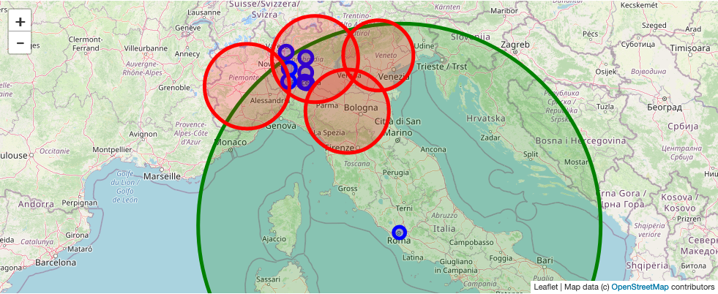
Visualize the data
Query map
To better understand the results decided to first show the areas that we searched for tweets.
For the map visualization the ipyleaflet python package used in jupyter notebook.
This is the query map, each circle is a query with a center location and different radius.
The color difference is just to distinguish between radius sizes.
Create a timeline of events
Define queries and geo locations
Download the data and arrange it
Pre-processing and classifying tweets
Visualize the data

Slide 12
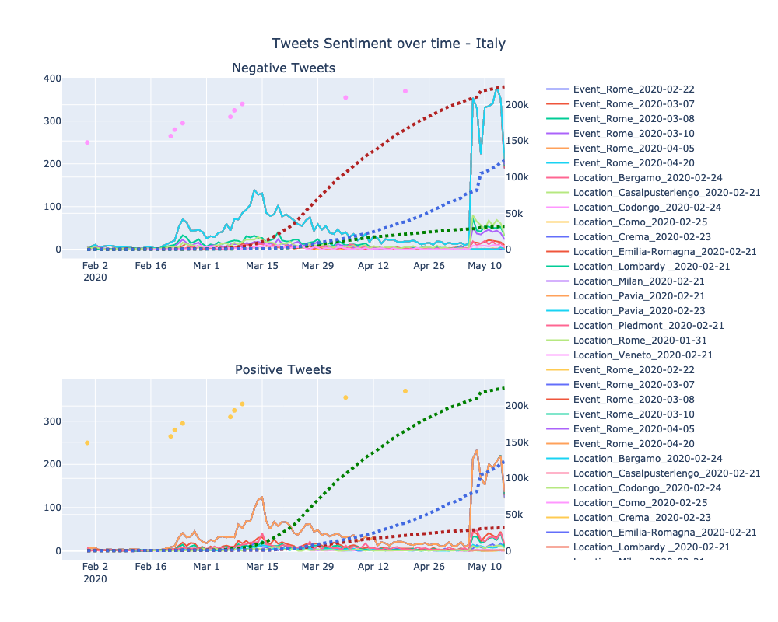
Visualize the data
Tweets sentiment over time
For plotting the results over graphs the plotly python package used in jupyter notebook to provide an interactive graphs to analyze the results in the best way.
The graphs separated into two groups:
Negative tweets.
Positive tweets.
Also, to provide a better picture a second axis added using the NOVELCovid/API to download historical data of the COVID19 case, recovered, death status on each day in Italy.
Create a timeline of events
Define queries and geo locations
Download the data and arrange it
Pre-processing and classifying tweets
Visualize the data

Slide 13
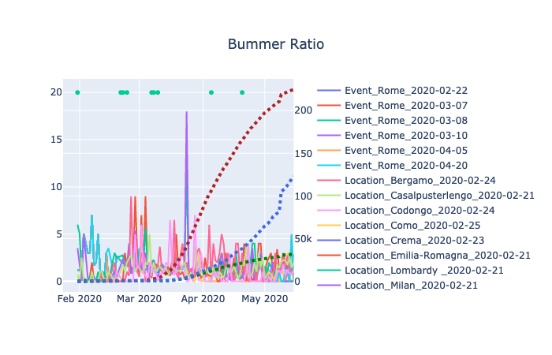

Visualize the data
Bummer Ratio
Using the results gathered additional ratio is introduced, the bummer ratio defined as:
$$bummer ratio= \frac{Negative tweets count}{Positive tweets count}$$
This “bummer ratio” is calculated for each query result for each day and then graphed on a separate graph with same secondary axis.
Create a timeline of events
Define queries and geo locations
Download the data and arrange it
Pre-processing and classifying tweets
Visualize the data

Slide 14
Conclusions

Slide 15
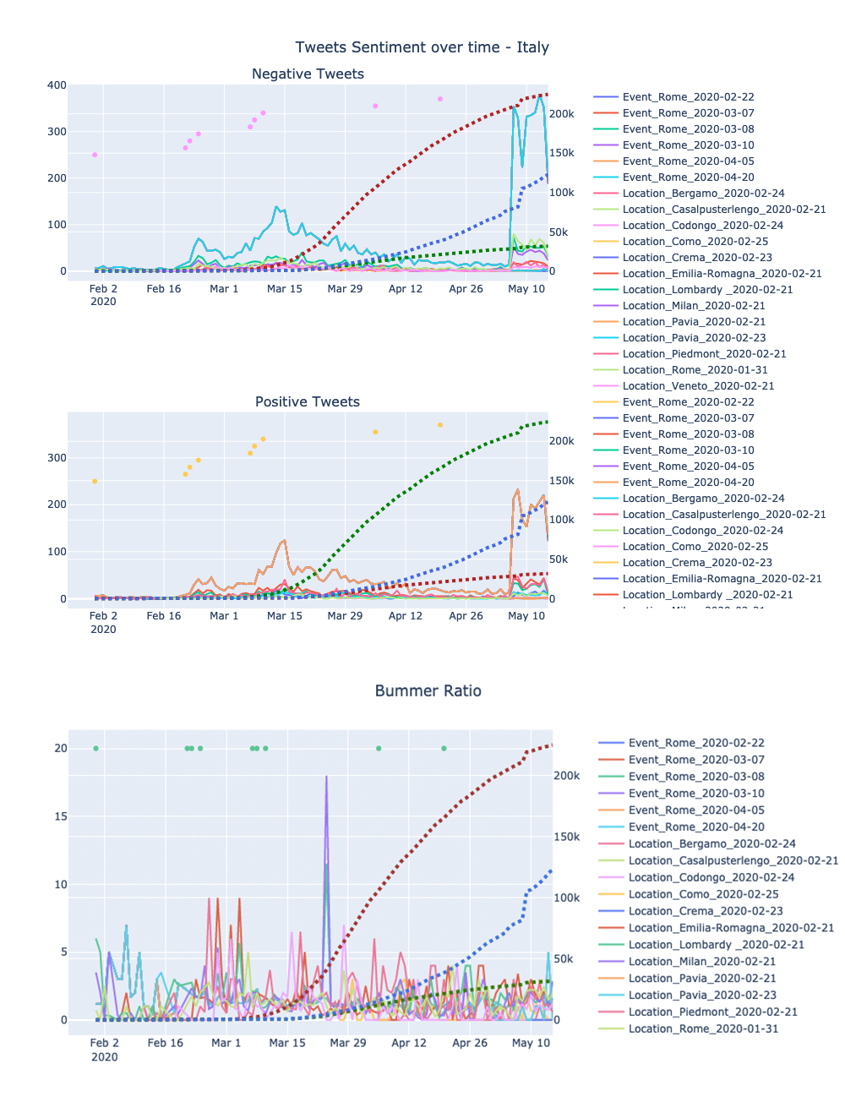
Conclusions
To analyze this plots we decided to separate the time line into 5 parts:
Part 1 – 19/02/20 – 06/03/20
Part 2 – 07/03/20 – 22/03/20
Part 3 – 23/02/20 – 06/04/20
Part 4 – 07/04/20 – 03/05/20
Part 5 – 04/05/20 – 15/05/20

Slide 16
Conclusions
Part 1 19/02/20 – 06/03/20
Major events:
21/02/20 – Increase in number of cases.
22/02/20 – Quarantine of more than 50000 people.
24/02/20 – Number of cases continues to increase rapidly.
04/03/20 - Educational institutions were closed
In the first part of the timeline we can see the effects of those major events on the amount of tweets with #coronavirus and how the COVID-19 gaining interest in the tweeter community. In the “bummer ratio” we can see the spikes that means strong negative feelings about the events.

Slide 17
Conclusions
Part 2 07/03/20 – 22/03/20
Major events:
07/03/20 – On 7 March, President of Lazio and leader of the Democratic Party, Nicola Zingaretti, tested positive for COVID-19. Ten days before, he was in Milan attending public events. The following day, President of Piedmont Alberto Cirio also tested positive.
08/03/20 - Starting on 8 March, the region of Lombardy together with 14 additional northern and central provinces in Piedmont, Emilia-Romagna, Veneto, and Marche, were put under lockdown.
Italy comes first in terms of mortality due to coronavirus. Every 20th sick person dies.
10/03/20 - Whole country lockdown.
19/03/20 – Italy surpassed China in the number of deaths due to coronavirus.
In the second part of the timeline we can see a further increase in tweets regarding the COVID-19. If we observe the “bummer ratio” we can see that the spikes are lower meaning that the number of negative/positive ratio is getting smaller.

Slide 18
Conclusions
Part 3 23/03/20 – 06/04/20
Major events:
23/03/20 – The first person who spent a long time in critical condition in intensive care is released.
24/03/20 – A press conference was held with the Prime Minister of Italy. They increased the fine for non-compliance with measures and refused to extend the state of emergency.
05/04/20 – Lowest number of daily deaths.
In the third part of timeline we can see a start of decrease in the amount of tweets regarding the COVID-19. The specific spike that we see in the “bummer ratio” may be connected to the press conference and the announcements of the new regulations.

Slide 19
Conclusions
Part 4 07/04/20 – 03/05/20
Major events:
20/04/20 – The first fall in the number of active cases.
During the fourth part of the timeline we can the lowest number of tweets regarding the COVID-19.
We can assume that the population learned to “live” with the virus and the new reality.

Slide 20
Conclusions
Part 4 04/05/20 – 15/05/20
Major events:
04/05/20 – Italy lifts quarantine restrictions.
06/05/20 – Record number of recovered, more than 8000 per day.
In the fifth part of the timeline we can see a significant rise in number of tweets regarding the COVID-19 largely due to this two major events that changed again the day-to-day routine.
Interesting to note that the “bummer ratio” is lowest during this part of the timeline and the meaning is that the negative/positive difference between the number of tweets is much closer.
Lower “bummer ratio” means that the population of Italy is much happier and this corresponds to this two events during the fifth part of the timeline.

